Slide 1
Putting Machine Learning Models into Production
Best Pretty Good Practices from a Data Scientist with Battle Scars
Tyler Byers
Senior Data Scientist
RiskLens

Slide 2

About Me
Senior Data Scientist @ RiskLens, Feb 2018 - current
Spokane, WA
Data Scientist, Machine Learning S/W Dev @ Itron, Comverge 2015-2018
Denver, CO
Manager, Data Collector, Data Analyst @ US Gov 2005-2015
I love Data Science, LinkedIn, coffee, R, Python.

Slide 3
Outline
Motivation, References
Definitions
Data Science Process for Productionizing Machine Learning Models
Other Good Practices: Brain Dump

Slide 4
Motivation
“How is ML put into production?
Hard to find MOOCs, university classes teaching this
Kaggle doesn’t teach it
Need on-job experience!
Notes:
image via despair.com

Slide 5
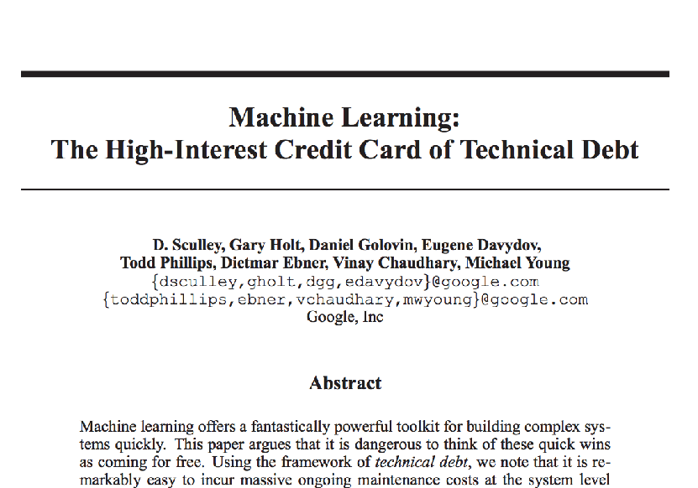
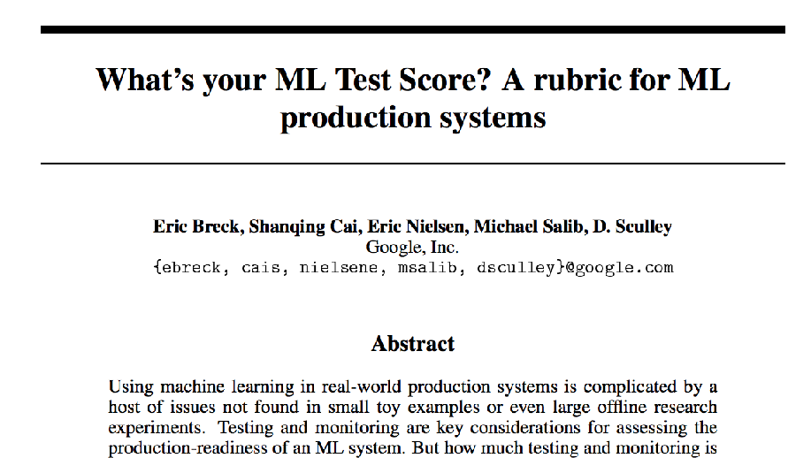
References - Read These!
https://research.google.com/pubs/pub43146.html
https://research.google.com/pubs/pub45742.html

Slide 6
Outline
Motivation, References
Definitions
Data Science Process for Productionizing Machine Learning Models
Other Good Practices: Brain Dump

Slide 7
Data Scientist - Conway’s Venn Diagram
Notes:
http://drewconway.com/zia/2013/3/26/the-data-science-venn-diagram
In a big company, the DS role might be split into ML engineer and DS.

Slide 8
“Productionized” Machine Learning
Think: “software”
Deployed as part of larger system
Automated
Seen by customer

Slide 9
Modern Machine Learning Languages

Slide 10
Outline
Motivation, References
Definitions
Data Science Process for Productionizing Machine Learning Models
Other Good Practices: Brain Dump

Slide 11




DS Process for ML Project
Scope Problem
Maintenance (ongoing)/new problem
Obtain Data
Analysis
Deploy Production Code
Write Up Results!
Write/Test Production Code
Discuss Results
Discuss Implementation

Slide 12
Outline
Motivation, References
Definitions
Data Science Process for Productionizing Machine Learning Models
Other Good Practices: Brain Dump

Slide 13

Analysis Items Beyond Normal DS Analysis
How long before your model gets “stale?”
How much training data do you need?
How long does your model take to train?
How quickly does it return a prediction?
How does it handle missing/Inf values?

Slide 14
Put Code in Packages or Modules
R: Write a package!
Python: Write a package or module
Much easier to maintain, unit test, transfer to new system, use on your own system

Slide 15
Keep Data Pipelines Separate
Data Pipelines should be handled outside of ML modules
Maybe some light transformation, feature engineering in ML code
Data Engineering, not Data Science

Slide 16
Know Git
Intermediate level at least
push, pull, commit, branch, merge

Slide 17
Write Unit Tests!!
You will thank me later
Small data snippets
Before writing code or after??
I don’t care! Whatever works.
Notes:
Image: https://www.toptal.com/qa/how-to-write-testable-code-and-why-it-matters

Slide 18

Name Things Well
Extra time naming things well is time well spent
CamelCase or underscores_btwn_words
Be consistent
R: Don’t name.like.this
Notes:
image: https://www.psychologytoday.com/blog/the-power-prime/201506/master-your-athletic-frustration

Slide 19
Help Your QA People
QA may need “fake” data to test your system
Help them! They have power to stop your algorithm
Help them understand why results from small test aren’t “reasonable,” but that’s ok

Slide 20
What is Good Enough Accuracy?
Most ML systems don’t need Kaggle-winning accuracy
Will a simpler model solve your customers’ problems?
Extra features: extra engineering time ($$$$). Is it worth it?
Notes:
image: https://www.pinterest.com/pin/194499277632753765/

Slide 21
Document, Document, Document
Document your code
R: roxygen2
Python: docstrings
Write vignettes for your engineers
Keep a blog

Slide 22
Maintenance: Keep Up with Your Shit
Most underrated aspect of ML in Production
Stuff breaks
Assumptions change
Users react to your ML algorithm
Know how to diagnose emergent problems
Revisit old projects!

Slide 23
Outline
Motivation, References
Definitions
Data Science Process for Productionizing Machine Learning Models
Other Good Practices: Brain Dump

Slide 24
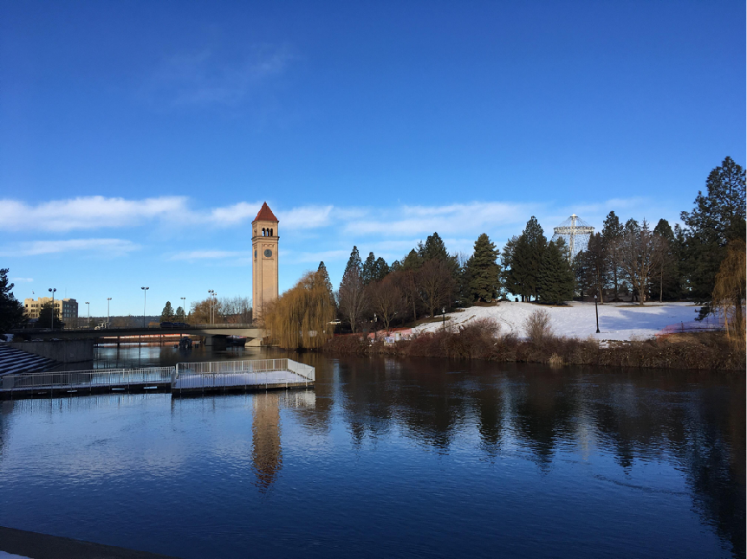
Thanks!
Contact:
Tyler Byers
Twitter @tylergbyers
LI: https://www.linkedin.com/in/tylerbyers/
These slides available on GH:
https://github.com/tybyers/ML_in_production_presentation

